Slide 1
“Let’s Build Cool Websites with React JS!”
Priyanka MAThur Nivedha ASOKAN

Slide 2
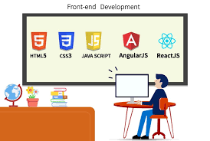
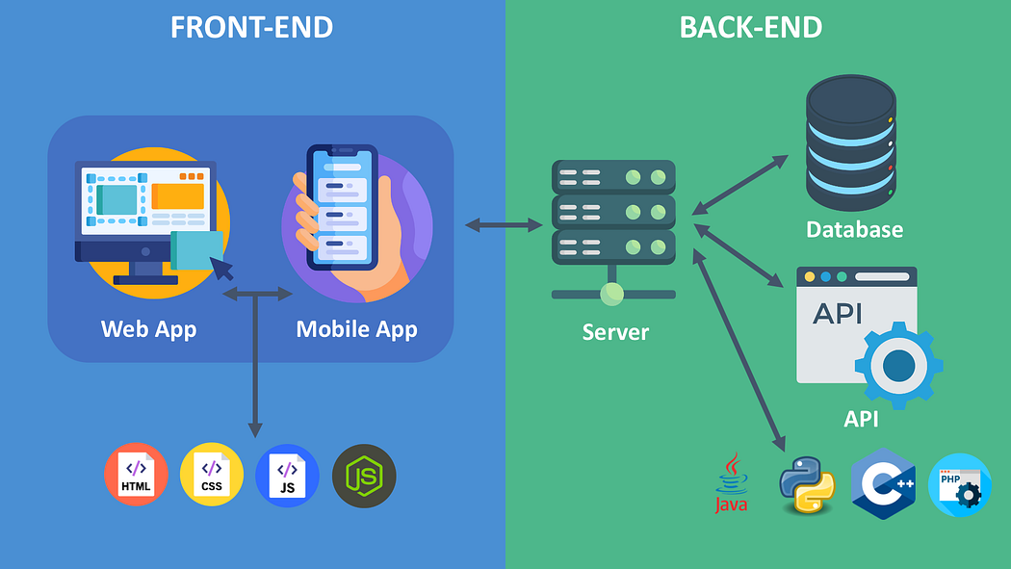
What is frontend development
Frontend development is the visible part of a website that users see and interact with.
It includes buttons, text, images, colors, and layout.
Example: When you open YouTube, the videos, buttons, search bar → all are frontend.

Slide 3
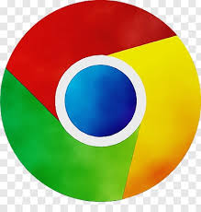


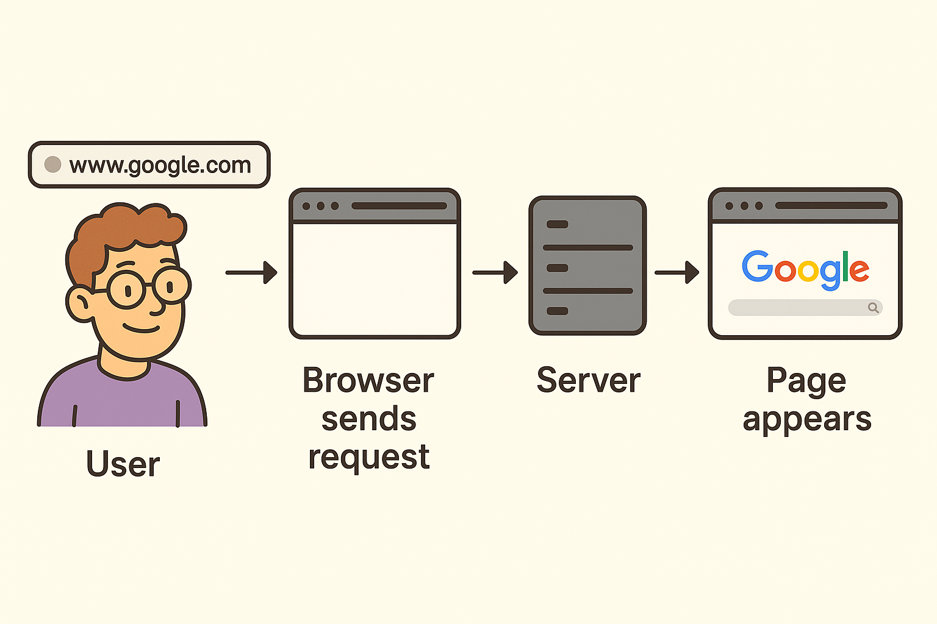
How the Web Works
Browser -
A browser is the tool you use to visit websites. When you type www.google.com in the address bar, the browser sends a request.
Server
The server is a powerful computer that stores websites. When your browser asks for a page, the server sends back the HTML, CSS, and JavaScript files

Slide 4
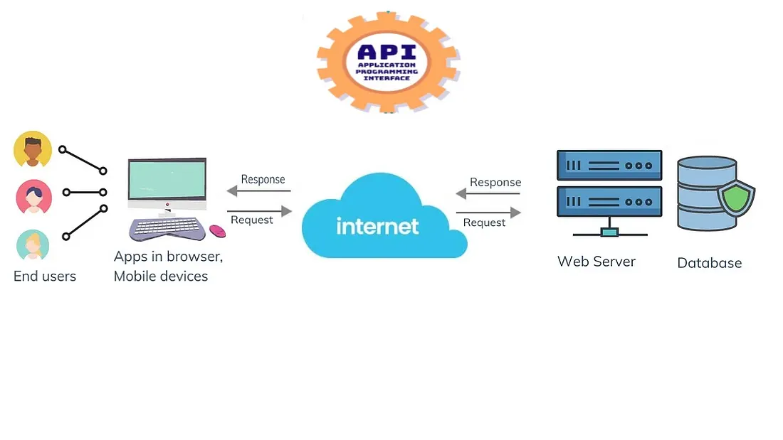
How the Web Works
APIs (Application Programming Interfaces)
APIs are like messengers that allow different apps or services to talk to each other.
Example: When a website shows Google Maps, it uses the Google Maps API to fetch data.

Slide 5
Introduction to HTML, CSS, and JavaScript
HTML (HyperText Markup Language) – Structure
HTML is the skeleton of a web page.
It defines headings, paragraphs, images, links, tables, forms, etc.
HTML = What you see (content).

Slide 6
HTML Concepts
Forms
Block & Inline
Tables
Semantic elements
Attributes

Slide 7
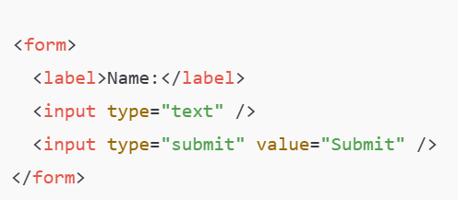
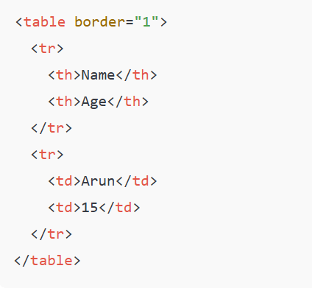
Tables
Forms
Collects user input.
A table in HTML consists of table cells inside rows and columns.

Slide 8
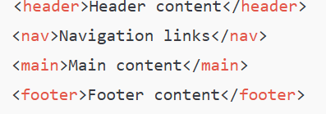
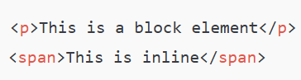
Semantic Elements
Block and Inline Elements
Block → starts on a new line (<div>, <p>, <h1>)
Inline → does not start on a new line (<span>, <a>, <strong>)
Gives meaning to the structure of a page.
Attributes
Provide extra information about elements.

Slide 9
For more, please refer: https://www.w3schools.com/html/default.asp

Slide 10
Introduction to CSS
CSS (Cascading Style Sheets) – Design
CSS is the clothing/decoration of a web page.
It controls colors, fonts, layouts, backgrounds, spacing.
CSS = How it looks (style)

Slide 11
CSS Concepts
Three ways of using style sheet
Box Model
Media Queries
Flex box
Grid

Slide 12
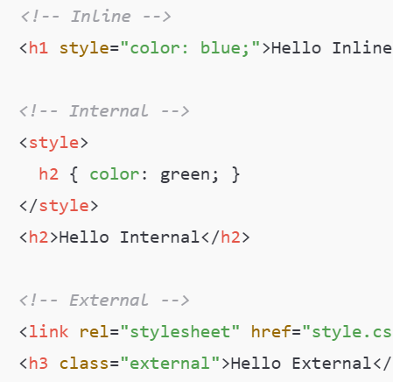
Three ways of using CSS
Three ways of using CSS
✅ Inline CSS → Styling directly inside the element
✅ Internal CSS → Inside <style> tag in HTML
✅ External CSS → Separate .css file

Slide 13
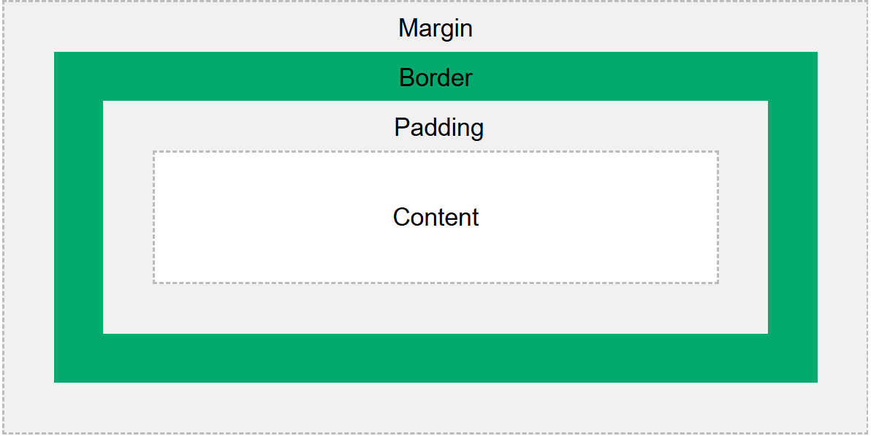
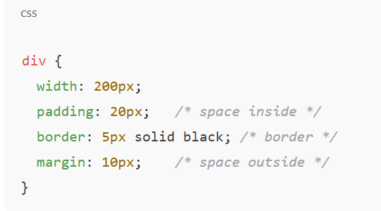
Box Model (content, padding, border, margin)
Every element in HTML is a box.

Slide 14
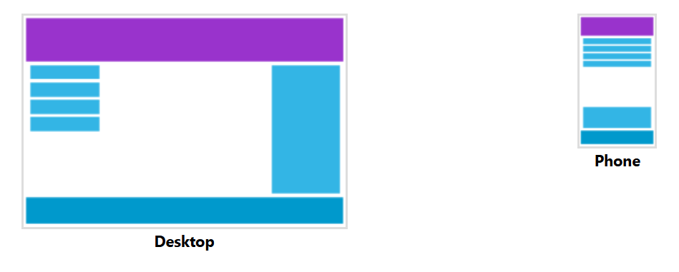
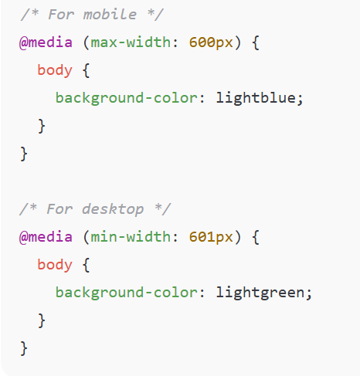
Media Queries (Responsive Design)
📱 Change style based on device width.

Slide 15
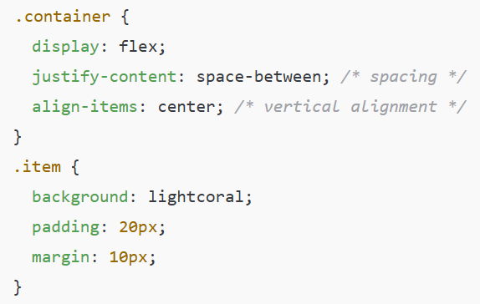
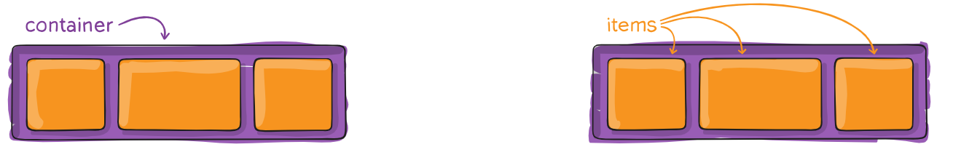
Flexbox (Flexible Box Layout)
🔄 Arrange items easily in row/column.

Slide 16
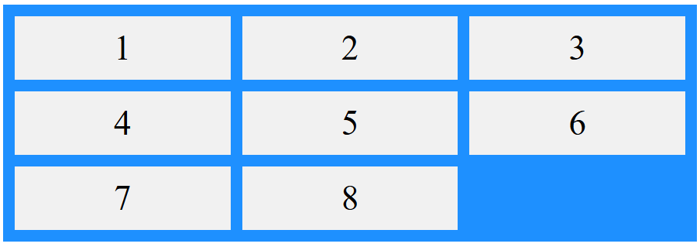
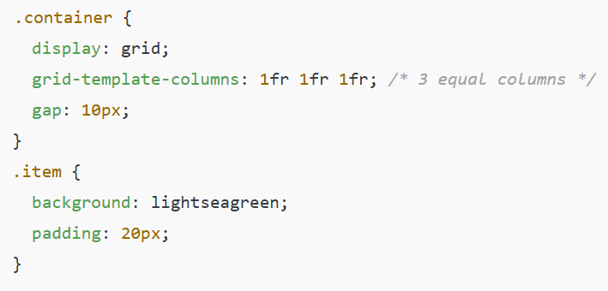
Grid Layout
🟦 Divide page into rows & columns.

Slide 17
For more, please refer: https://www.w3schools.com/css/default.asp

Slide 18
Introduction to JavaScript
JavaScript – Interactivity
JavaScript makes web pages dynamic and interactive.
It can respond to clicks, inputs, animations, validations.
JavaScript = How it behaves (interactivity)
Example: Playground | MDN

Slide 19
JavaScript Concepts
Variables
Date Types
Loops
Switch statement
Logical Operators
Functions
Arrow functions
Objects
Arrays
Destructuring
Mouse events
Fetch
Localstorage & Sessionstorage
Async/await
Template Literals

Slide 20
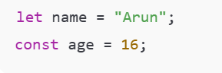
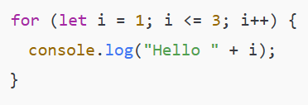
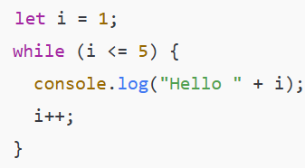
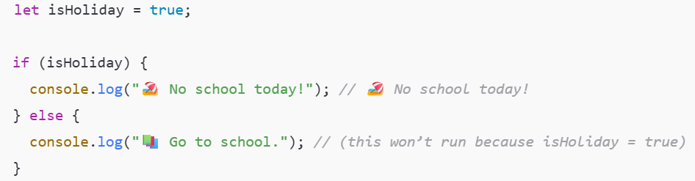
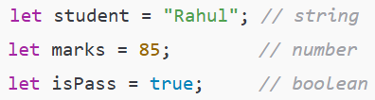
JavaScript Concepts
Variables: Used to store data.
Data Types: string, number, boolean, object, array, null, undefined.
Loops: Run code repeatedly.
If…else: used to make decisions in code.

Slide 21
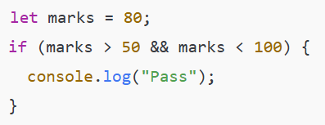
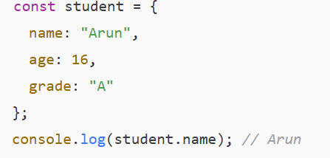
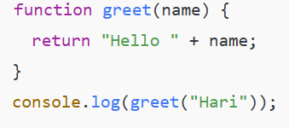
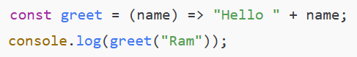
JavaScript Concepts
Logical Operators: && (AND), || (OR), ! (NOT).
Functions: Block of code that performs a task.
Objects : Store data in key-value pairs.
Arrow functions: Shorter way to write functions.

Slide 22
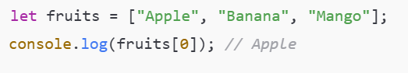
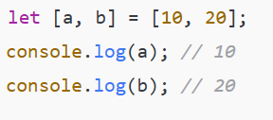
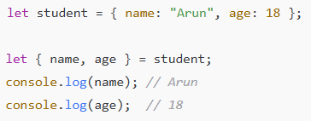
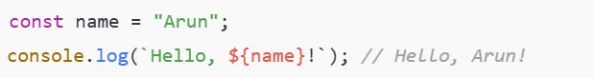
JavaScript Concepts
Arrays : A collection of values stored in a single variable.
Destructuring : Extract values from arrays or objects easily.
Mouse Events : Events that happen when the user interacts with the mouse
Template literals: Let you build strings using backticks (`) instead of quotes.
You can embed variables or expressions inside a string using ${ }.

Slide 23
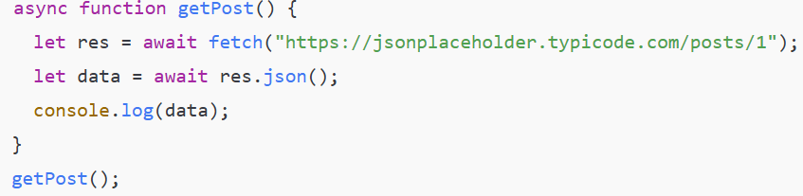
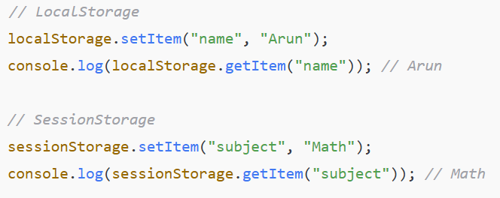
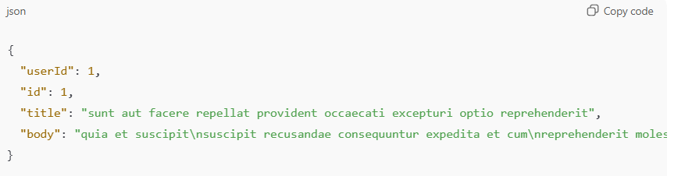
JavaScript Concepts
LocalStorage & SessionStorage : Store data in the browser.
Async/Await : A cleaner way to write asynchronous code.

Slide 24
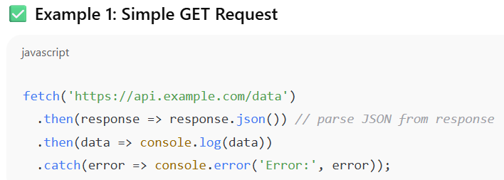
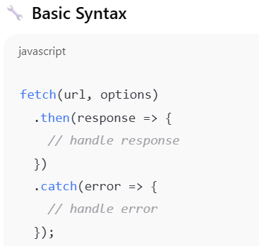
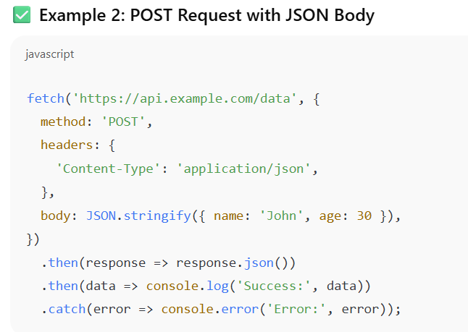
JavaScript Concepts
Fetch (API calls) : Built-in function used to make HTTP requests (GET, POST, PUT, DELETE, etc.) from the browser to a server.

Slide 25
For more, please refer: https://javascript.info/

Slide 26
Developer Tools
Built inside Chrome (Right click → Inspect).
Used by developers to:
- Inspect elements (see the HTML & CSS behind a page).
- Debug JavaScript (find and fix errors).
- Check responsiveness (how a website looks on mobile/desktop).

Slide 27
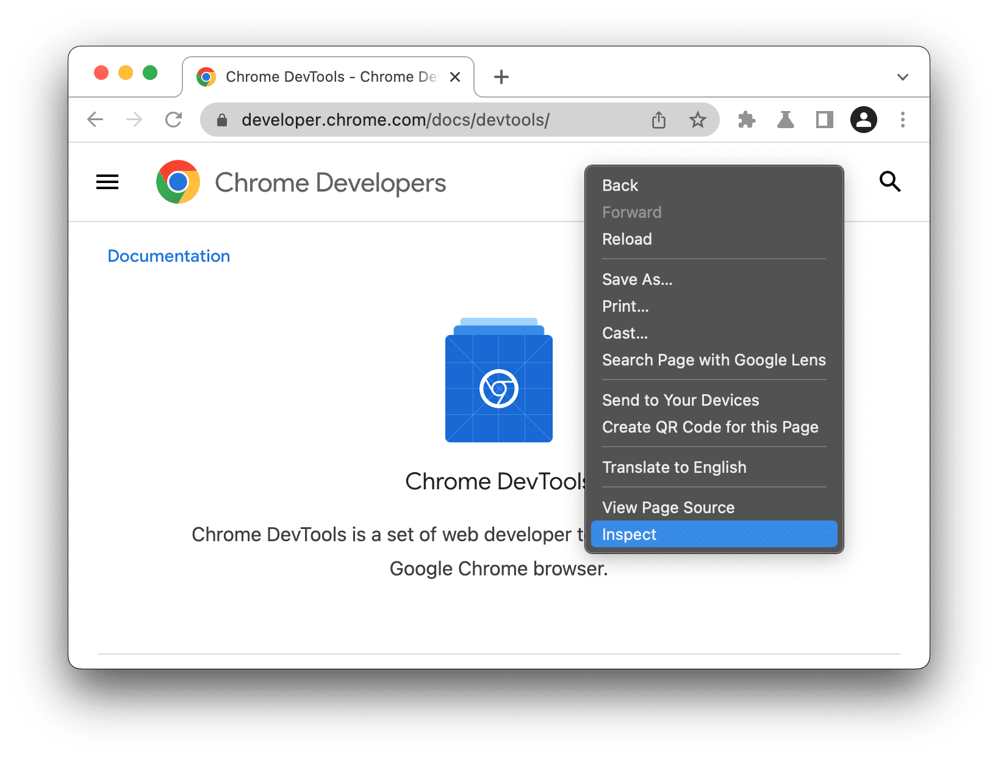
Developer Tools

Slide 28
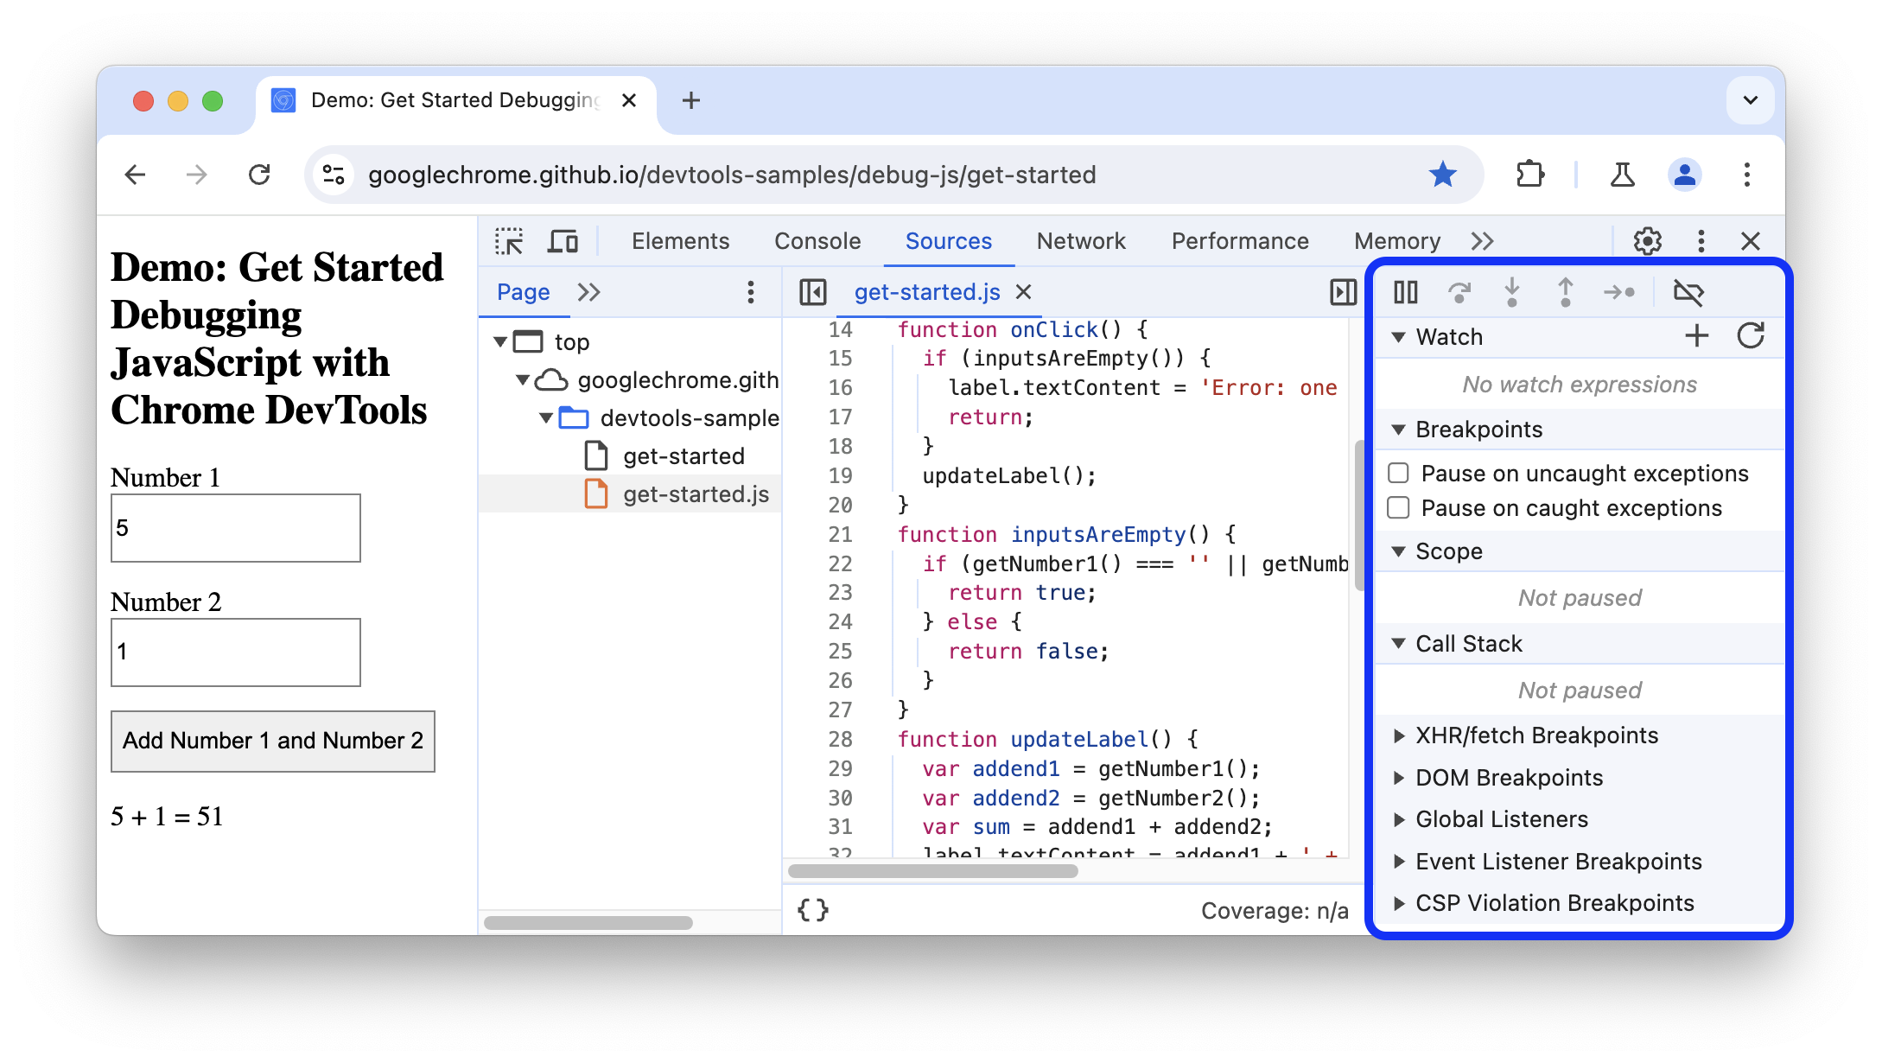
Developer Tools

Slide 29
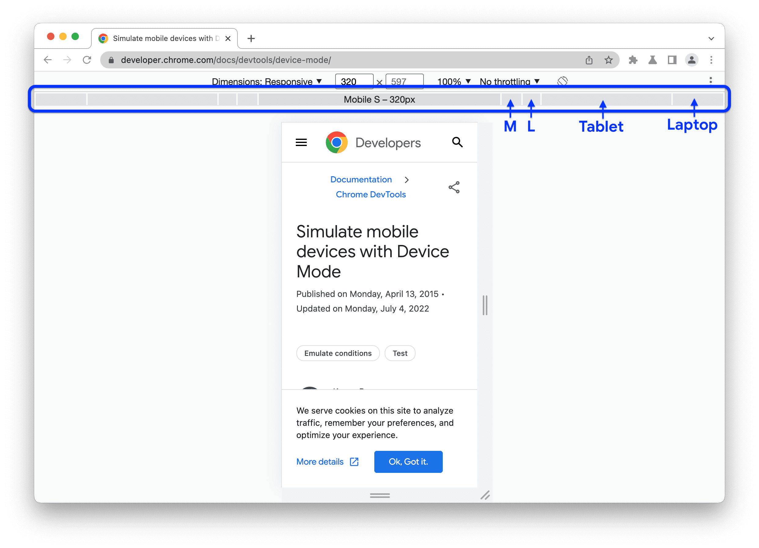
Developer Tools

Slide 30
Using VS Code
Visual Studio Code (VS Code) = a free code editor for writing programs.
Supports HTML, CSS, JavaScript, and many more languages.
Features:
- Extensions (to make coding easier).
- Themes (customize look).
- Built-in terminal (run commands).

Slide 31
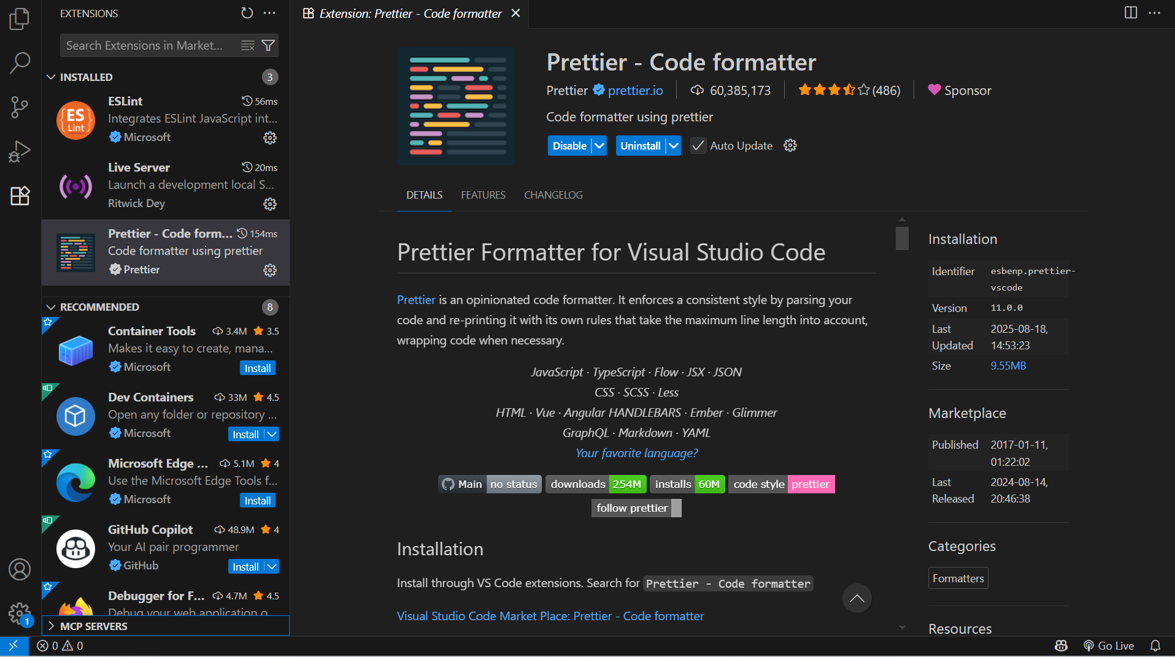
Using VS Code

Slide 32
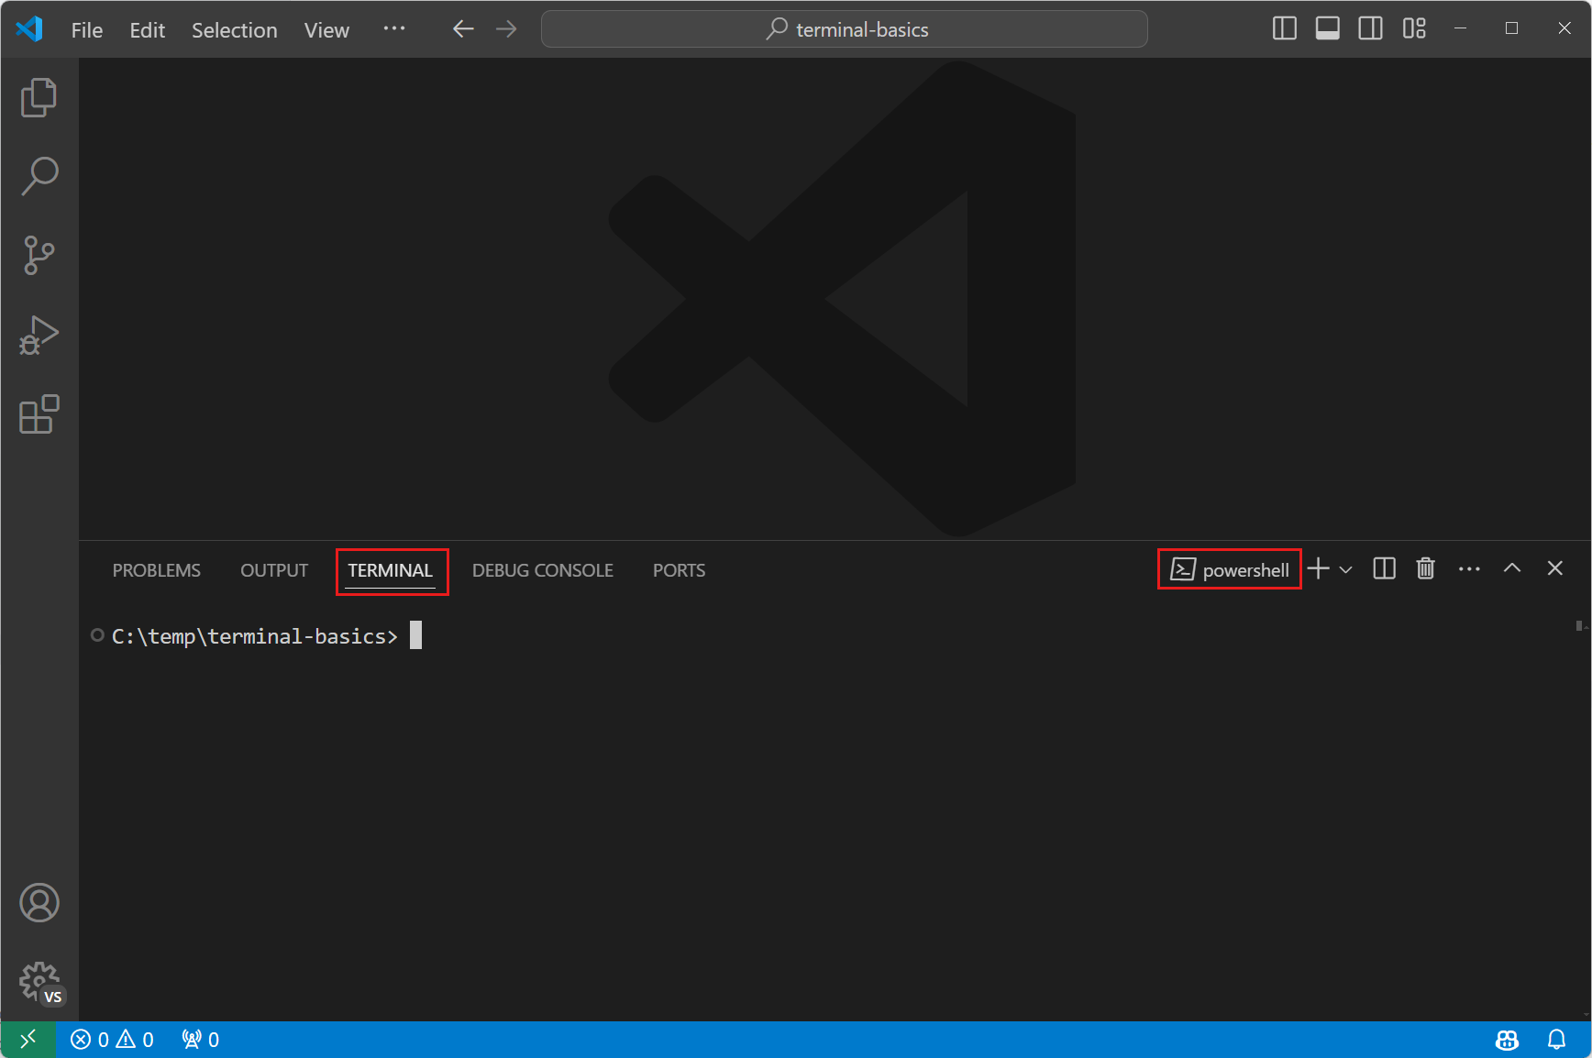
Using VS Code

Slide 33
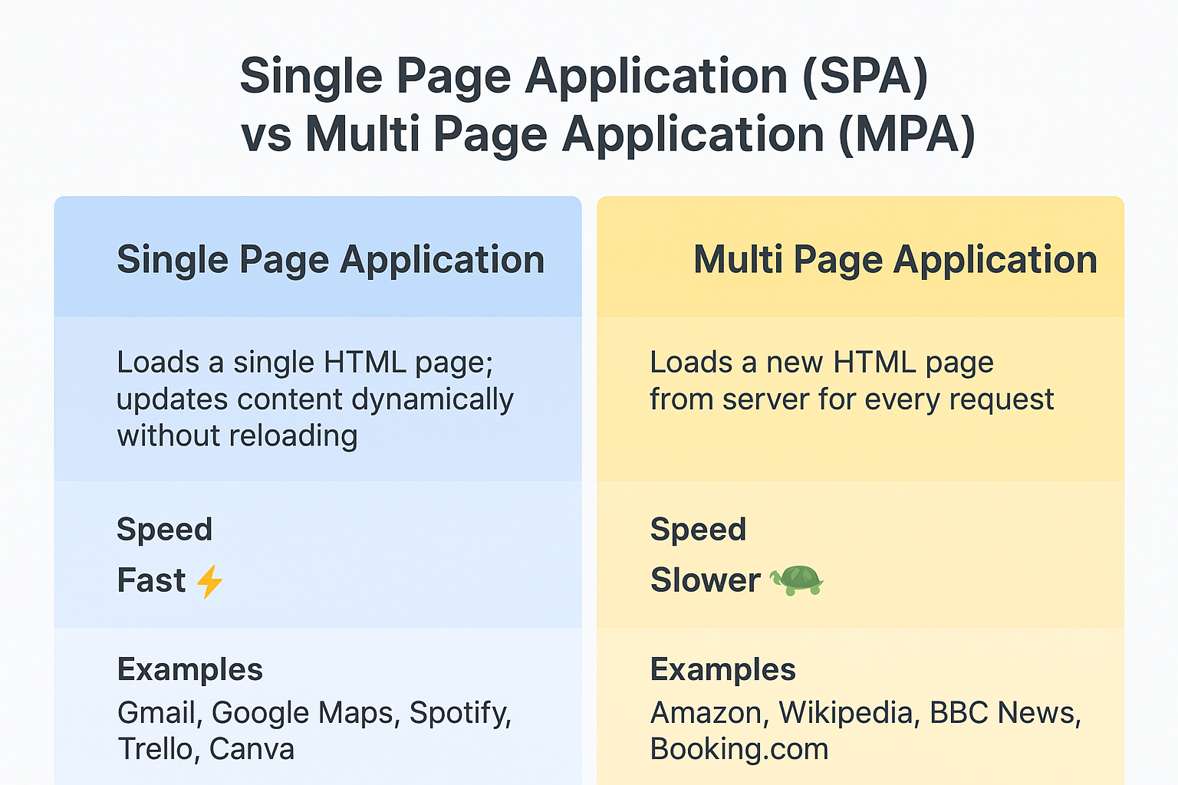
Slide Title, Segoe UI, 24pt, Max. 2 Lines

Slide 34
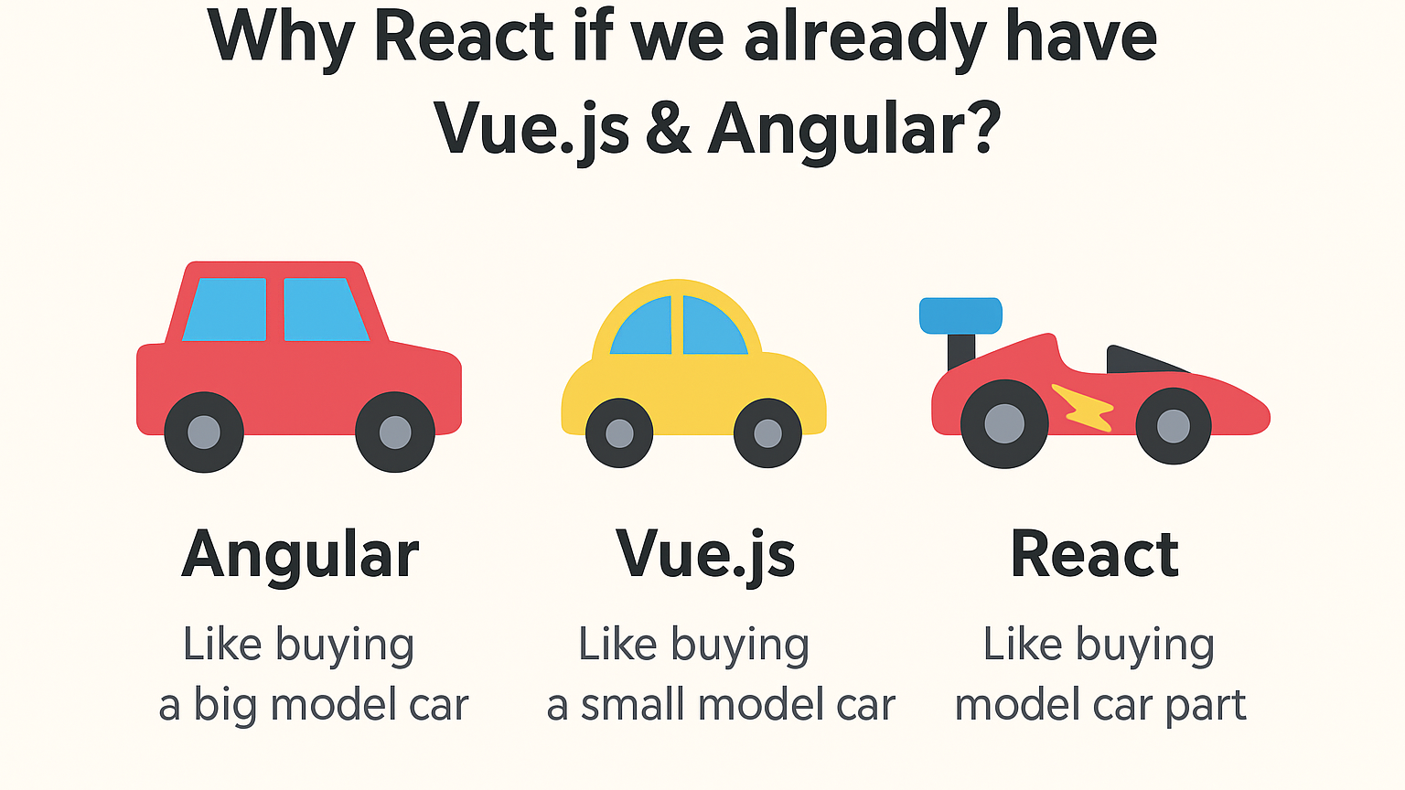
Slide Title, Segoe UI, 24pt, Max. 2 Lines

Slide 35
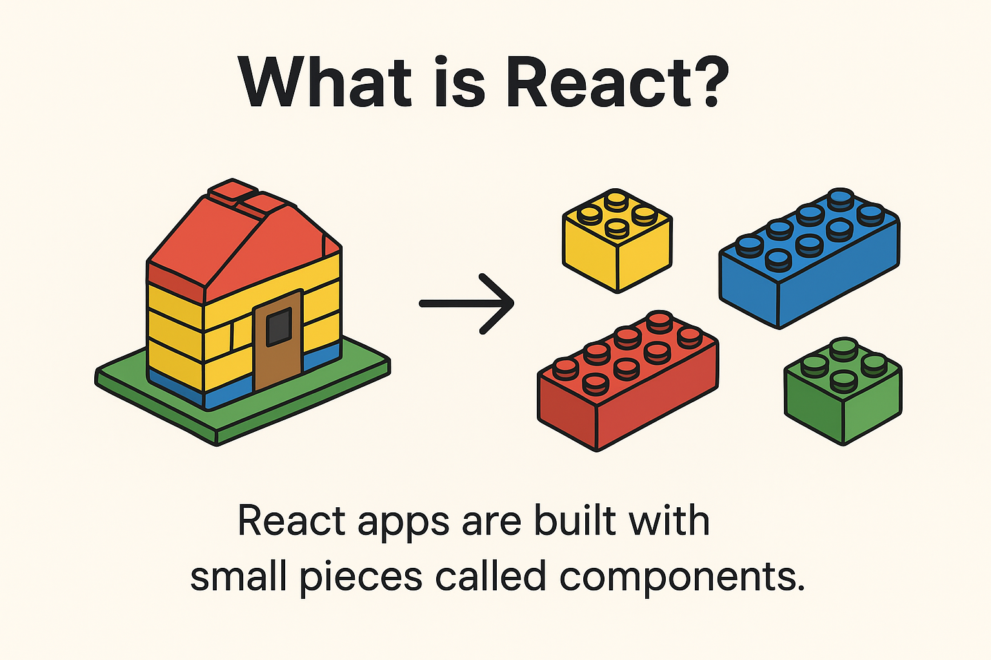
Introduction to react

Slide 36
Key features
📦 Component-based → Breaks big app into small pieces.
⚡ Fast → React updates only the part of the screen that changes.
🔄 Reusable → Build once, use many times.
🌍 Popular → Used by companies like Instagram, Netflix, Flipkart, etc.
How React works
Break UI into Components → (e.g., Button, Header, Footer).
Write JSX → Code looks like HTML inside JavaScript.
Virtual DOM → React tracks changes and updates only what’s needed.
Render UI → Browser shows updated content instantly.

Slide 37
Setting up a React Project with Vite
Prerequisites:
✅ Install Node.js (latest LTS version) → https://nodejs.org ✅ Install a code editor (VS Code).
Create a React Project with Vite
Open VS Code → Command prompt

Slide 38
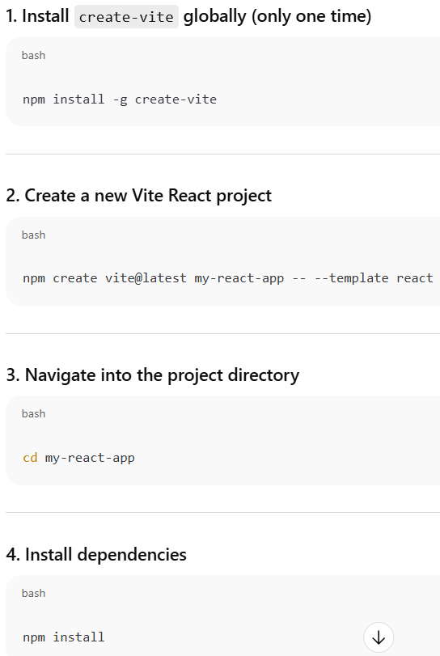
Create a react project

Slide 39
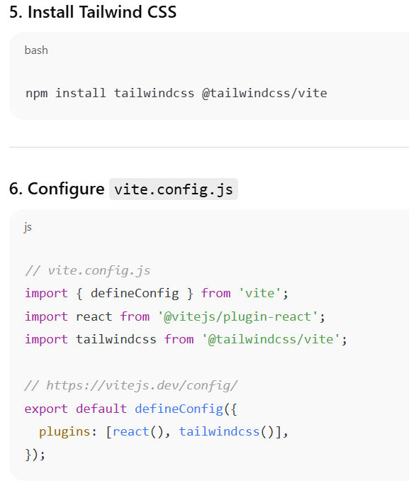
Create a react project

Slide 40
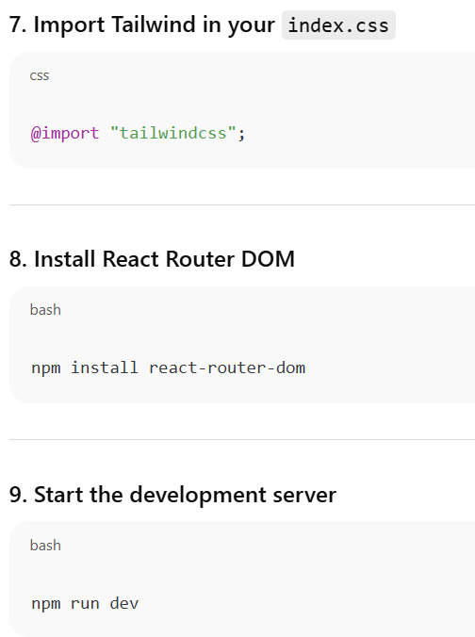
Create a react project
Open the link (e.g., http://localhost:5173/) in the browser → Your React app is running 🎉

Slide 41
JSX – Writing HTML inside JavaScript
HTML
<!DOCTYPE html>
<html>
<head>
<title>HTML Example</title>
</head>
<body>
<h1>Hello World</h1>
</body>
</html>
JAVACRIPT
<script>
const name = "World";
const root = document.getElementById("root");
const heading = document.createElement("h1");
heading.textContent = "Hello " + name;
root.appendChild(heading);
</script>
JSX
const name = "World";
function App() {
return <h1>Hello {name}</h1>;
}
export default App;

Slide 42
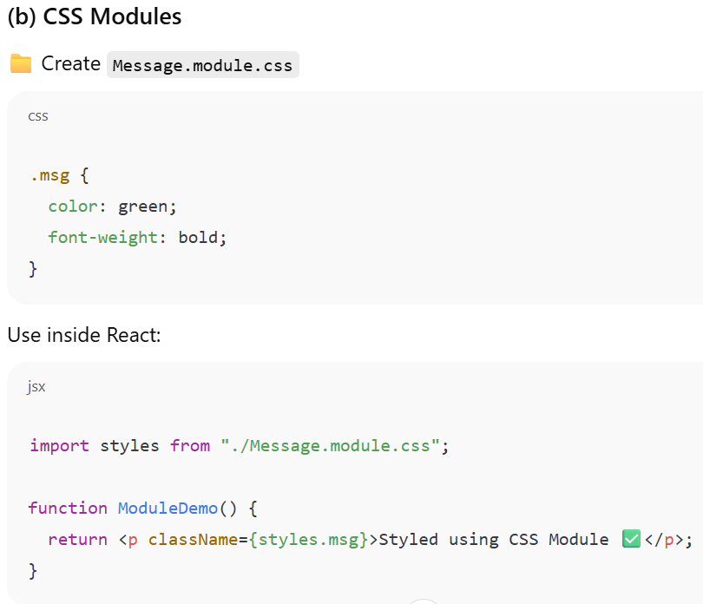
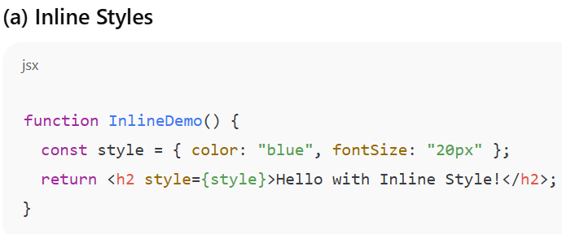
CSS Modules & Inline Styles

Slide 43


Tailwind CSS
bg-blue-500 → Medium blue background (shade 500).
text-white → White text for contrast.
px-4 → 16px padding left & right.
py-2 → 8px padding top & bottom.
rounded → Smooth, slightly rounded corners.

Slide 44


FRAgment
A Fragment lets you group multiple elements without adding an extra <div> in the DOM.
Normally React components must return one parent element. If you don’t want an extra <div> just for grouping then Fragment come in.

Slide 45

Slide Title, Segoe UI, 24pt, Max. 2 Lines

Slide 46


What is the difference?
Feature | Functional Component | Class Component
Syntax | Function / Arrow function | ES6 Class
State | useState Hook | this.state
Lifecycle | useEffect Hook | Lifecycle methods
Code length | Short & clean ✅ | Longer
Modern React | ✔️ Recommended | ❌ Less used

Slide 47

Event Handling

Slide 48

Event Handling
Events are actions that happen in the browser.
Examples: Button click, typing in a textbox, mouse hover, etc.

Slide 49
What are Props in React?
Props = Properties
They are like arguments to a function.
Props let us pass data from one component to another. (i.e., parent to child)
Read-only → a child component can use them but cannot change them.

Slide 50


Slide Title, Segoe UI, 24pt, Max. 2 Lines

Slide 51

Slide Title, Segoe UI, 24pt, Max. 2 Lines

Slide 52

Passing Data from Child to Parent

Slide 53

Child → Parent communication

Slide 54

Child → Parent communication

Slide 55

State - Using useState to manage data
State = a component’s memory
state belongs to the component itself.
When state changes → React re-renders the UI automatically.

Slide 56

Slide Title, Segoe UI, 24pt, Max. 2 Lines

Slide 57

Slide Title, Segoe UI, 24pt, Max. 2 Lines

Slide 58
useEffect

Slide 59
What IS USEEFFECT And How to use it?
useEffect lets you run code when your component mounts, updates, or unmounts.
🟢 Mounts -> runs only once, when the component first appears on the screen.
🟡 Updates -> When you pass a state (or prop) inside the dependency array [ ], the code inside useEffect runs only when that value changes
🔴 Unmounts -> When a component is removed from the screen , React will run the cleanup function you return from useEffect

Slide 60

Slide Title, Segoe UI, 24pt, Max. 2 Lines

Slide 61

Slide Title, Segoe UI, 24pt, Max. 2 Lines

Slide 62


Conditional rendering (Hide/Show)

Slide 63


Lists and Keys

Slide 64




Forms in react

Slide 65

Event handling

Slide 66

Slide Title, Segoe UI, 24pt, Max. 2 Lines
In React, events use camelCase names like onClick, onChange, onSubmit.
You give the event a function → React will run that function when the event happens.

Slide 67
WHAT IS AN API?

Slide 68

Event handling

Slide 69

JSON
Looks like text → Easy for humans to read.
Has keys and values → like “name”: “Rahul”.
Language-independent → not just for JavaScript; almost every programming language can use JSON.
Mostly used in APIs → Apps send and receive data in JSON.

Slide 70

Json example

Slide 71

Using fetch with async/await
fetch() is a built-in JavaScript function, so no extra library is required.
Example: fetching a list of posts from a fake API https://jsonplaceholder.typicode.com/posts

Slide 72

Using fetch with .then()

Slide 73

Handle loading & Errors
Why do we use a loader?
Imagine you order food in a restaurant 🍔.
While waiting, the waiter says: “Please wait, your food is being prepared.”
What is error handling in React?
Error handling catches mistakes, stops the app from crashing.
It tells the user what went wrong instead of leaving them confused.

Slide 74

Rendering API data in UI
Posts
Hindi
English
Math
Science
Social

Slide 75

Introduction to react Router
React Router helps us create multiple pages inside a React app without reloading the whole website.
It’s what makes Single Page Applications (SPA) feel like they have multiple pages.

Slide 76


CREATING MULTIPLE pages

Slide 77

Navigation between components
When you click Home → it loads <Home />
When you click About → it loads <About />
When you click Contact → it loads <Contact />

Slide 78
🚀 Preparing React App for Production

Slide 79

How to build A project
Once the development is finished, then build the application.
This creates a dist (Vite) folder with optimized files ready for hosting.

Slide 80

Git & GitHub Basics
Git helps us track changes in code, and GitHub stores it online.

Slide 81

Deploy on Netlify
Go to https://netlify.com
Login (students can use GitHub account).
On Netlify dashboard → click "Add new site" → "Deploy manually“
Drag and drop your dist folder (Vite) into the upload area
Netlify will host your app instantly. You’ll get a free live URL like:

Slide 82

Thank you.

